Slide 1
Dynamic Simulations

Slide 2
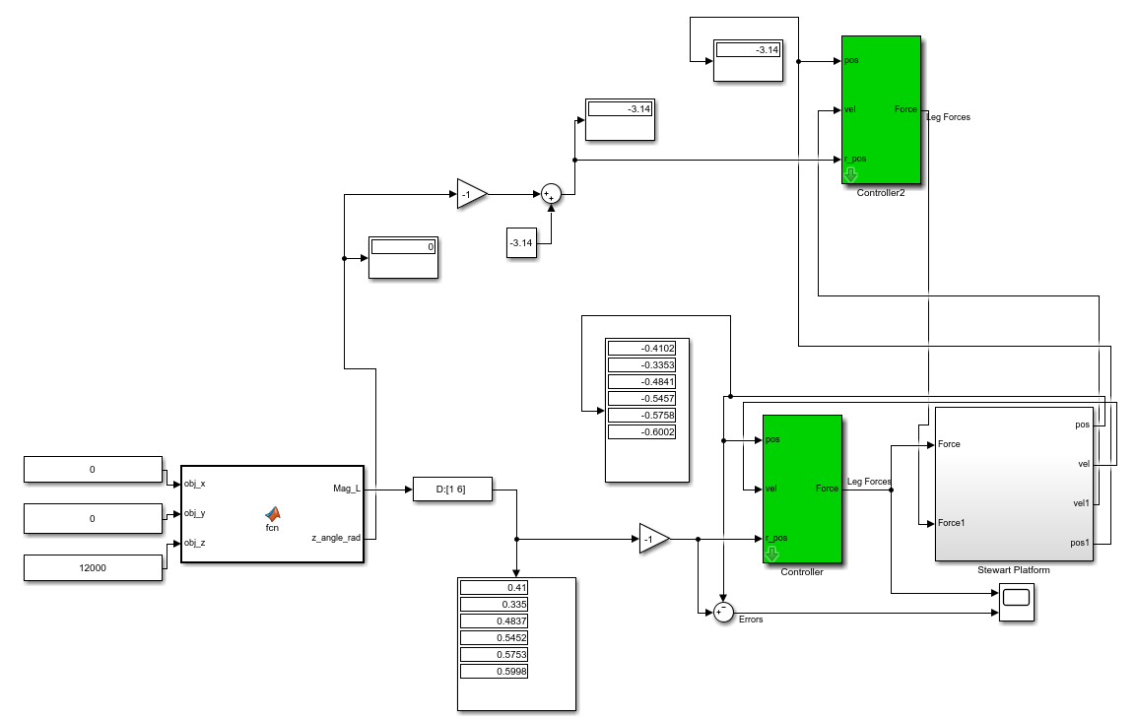
PID controllers for bearing rotation and linear actuators movement
Inverse Kinematics code
Inputs: x, y, z coordinates of an object
Outputs: array of leg lengths and rotation angle of the bearing
Imported solids form Solidworks

Slide 3
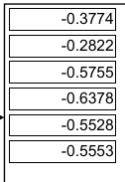
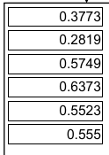
 | Inverse Kinematics | Dynamic Simulation
Leg 1 | 0.3773 m | 0.3774 m
Leg 2 | 0.2819 m | 0.2822 m
Leg 3 | 0.5749 m | 0.5755 m
Leg 4 | 0.6373 m | 0.6378 m
Leg 5 | 0.5523 m | 0.5528 m
Leg 6 | 0.5550 m | 0.5553 m

Slide 4
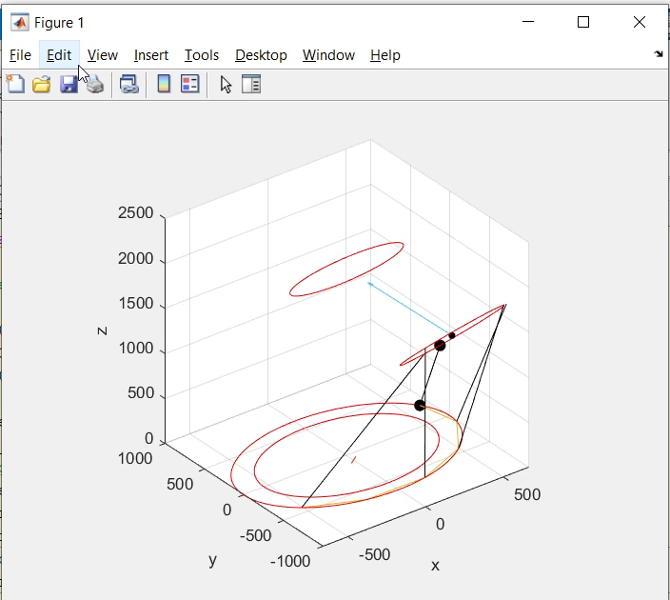
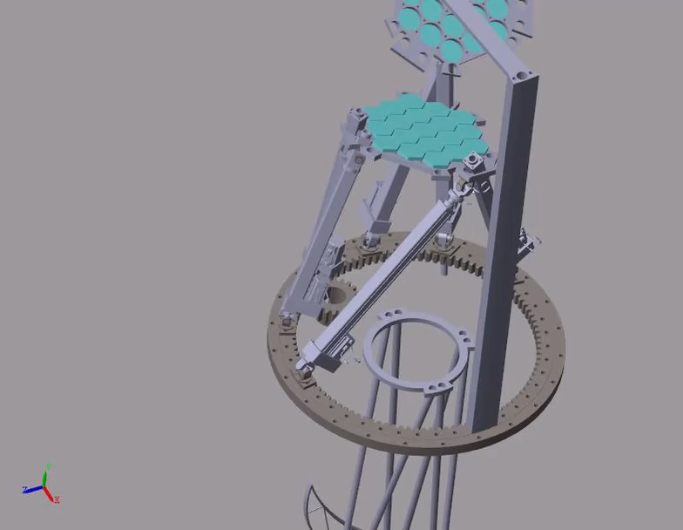
Experiment 1
X: 0
Y: 1187
Z: 3678

Slide 5
S
Adjust PID coeffs to find optimal time using preinstalled matlab libraries/packages.
Add raytracing to the Simulink simulation
Add dome over the telescope in Simulink simulation
Study the difference between active optics and adaptive optics
Understand the code for mirror control, and adapt it to Simulink model

Slide 6
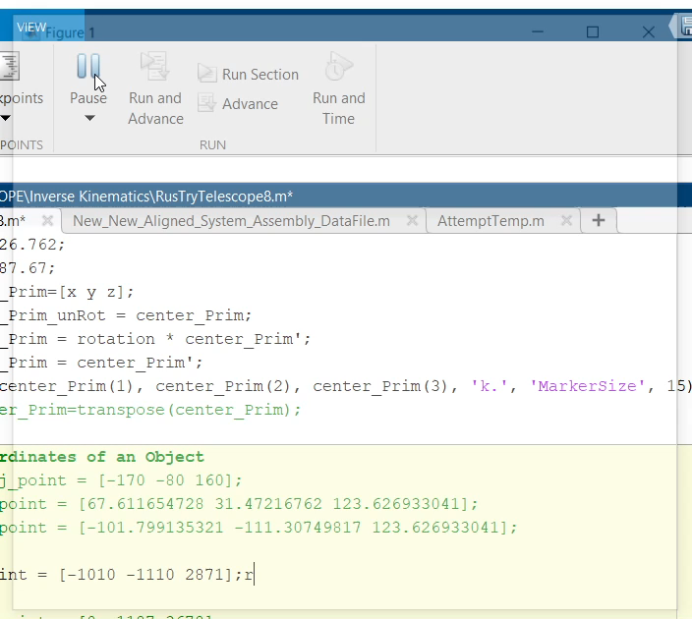
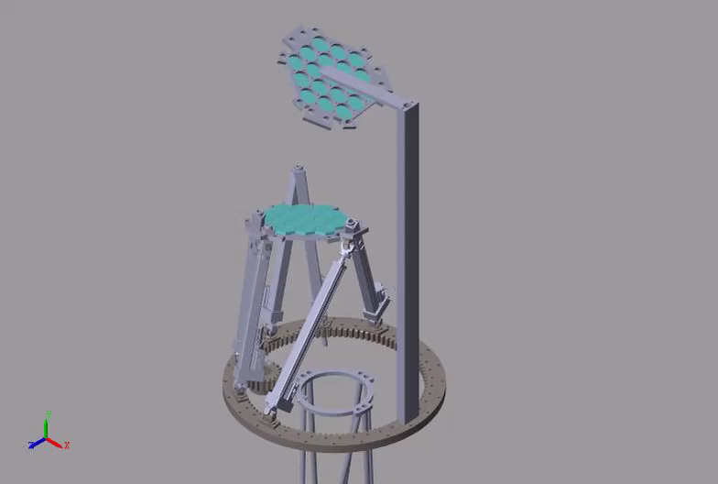
Experiment 2
X: -1010
Y: -1110
Z: 2871

Slide 7
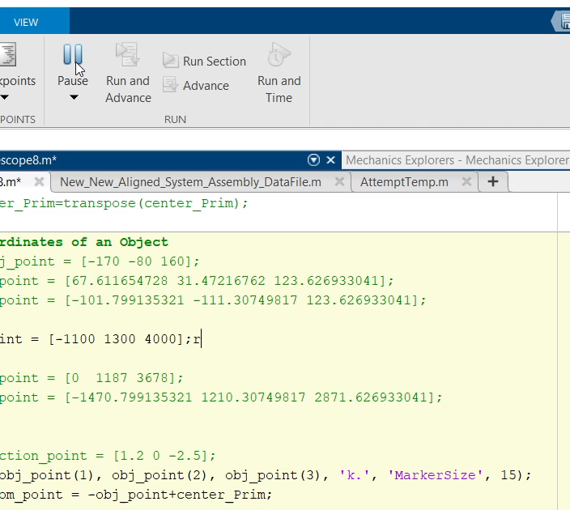
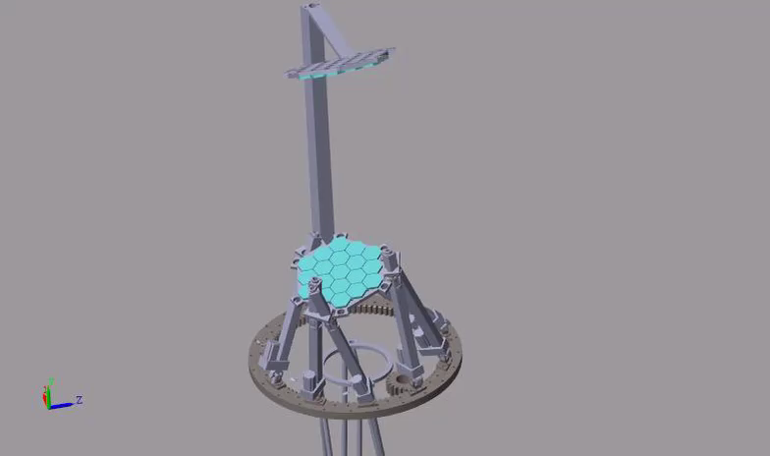
Experiment 3
X: -1100
Y: 1300
Z: 4000

Slide 8
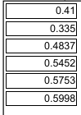
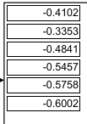
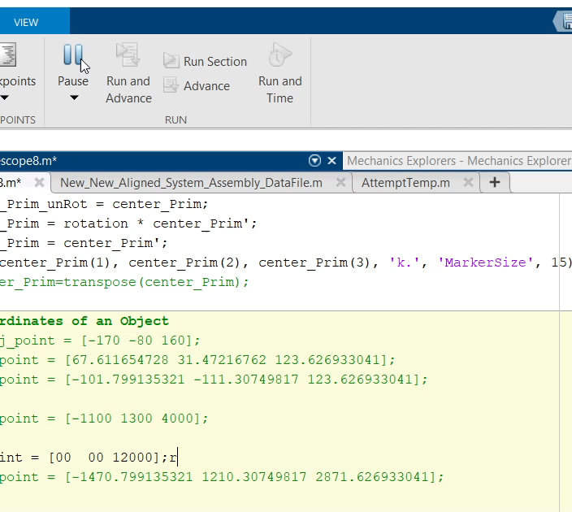
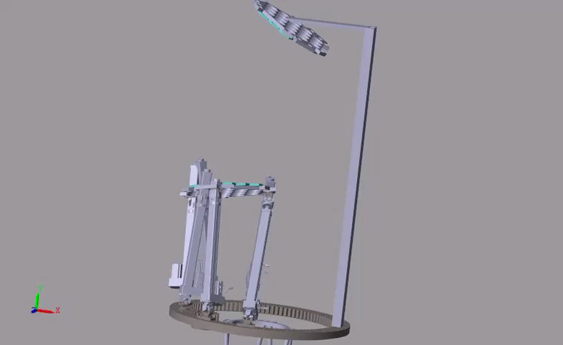
Experiment 4
X: 0
Y: 0
Z: 12000

